Slide 1
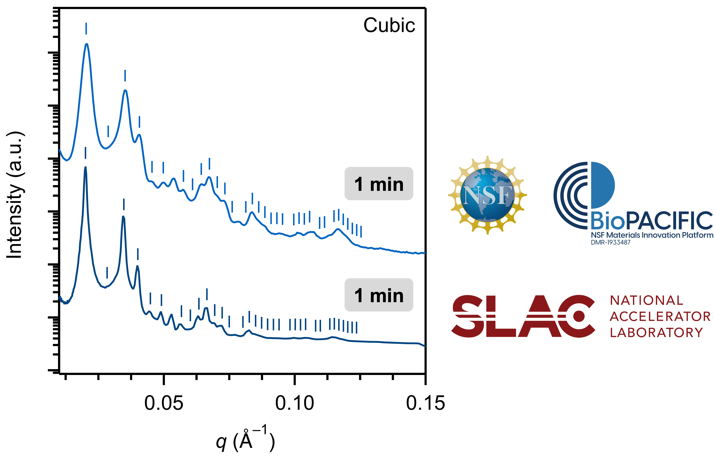
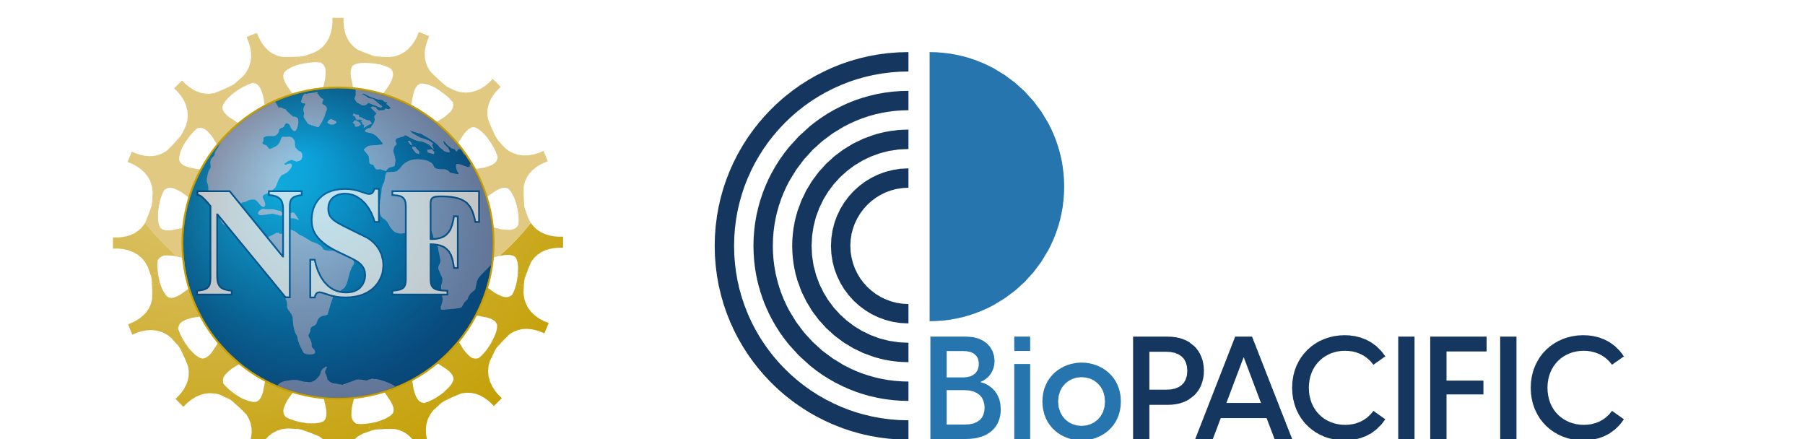
Efficient Creation and Morphological Analysis of ABC Triblock Terpolymer Libraries
BioPACIFIC MIP at UCSB & UCLA, DMR-1933487
In-house Research - 2022
Elizabeth A. Murphy, Yan-Qiao Chen, Kaitlin Albanese, Jacob R. Blankenship, Allison Abdilla, Morgan W. Bates, Cheng Zhang, Christopher M. Bates, Craig J. Hawker, UC Santa Barbara
What was achieved?:
A versatile and scalable strategy to separate parent triblock terpolymers into libraries of fractionated samples spanning a wide range of compositions was developed. Using a combination of controlled polymerization and automated chromatography, the synthesis and separation of less than 10 ABC and ACB parent materials gave rise to over 100 purified triblock terpolymers. This general technique eases the synthetic burden associated with exploring the multi-block copolymer phase space and, in conjunction with morphological analysis, accelerates the study of structure−property relationships in multi-block polymers.
Why is it important?:
Multiblock copolymers with increasingly complex block sequences offer unique opportunities to create nanostructured materials. The developed user-friendly separation strategy significantly increases the availability of well-defined ABC triblock terpolymer libraries to the polymer community while also improving sample quality and accelerating discovery. As evidenced by small-angle X-ray scattering, fractionation enhances long-range order compared to as-synthesized parent materials and allows for the definitive identification of the material’s structure. This enhanced discovery process is a powerful strategy for mapping the phase behavior of multi-block polymers with increasingly complex architectures and well-defined monomer sequences and is important to support the greater range of block copolymer possibilities enabled by advances in controlled polymerizations.
How did BioPACIFIC MIP enable this?
This work used the BioPACIFIC MIP X-ray Diffraction Platform for small angle X-ray scattering measurements of triblock terpolymers. The BioPACIFIC MIP SAXS enables rapid morphological analysis of block copolymers through a high brilliance liquid metal X-ray source and large detector, giving synchrotron-level data on a benchtop system. Over 20 q reflections were observed, which could not be realized by previous benchtop SAXS instruments.
Figure 1. ABC triblock terpolymer (a polymer synthesized by ring-opening and atom transfer radical polymerization from three different monomers)
Figure 2. The new X-ray Facility Brings Synchrotron-level Capabilities to BioPACIFIC MIP: scattering intensities from the ABC triblock terpolymer, as measured at the BioPACIFIC MIP and the SLAC National Accelerator Laboratory.
Publication: Macromolecules, ASAP.
https://doi.org/10.1021/acs.macromol.2c01480
Notes:
What Has Been Achieved: A versatile and scalable strategy to separate parent triblock terpolymers into libraries of fractionated samples spanning a wide range of compositions was developed. Using a combination of controlled polymerization and automated chromatography, the synthesis and separation of less than 10 ABC and ACB parent materials gave rise to over 100 purified triblock terpolymers. This general technique eases the synthetic burden associated with exploring the multi-block copolymer phase space and, in conjunction with morphological analysis, accelerates the study of structure−property relationships in multi-block polymers.
Importance of the Achievement: Multiblock copolymers with increasingly complex block sequences offer unique opportunities to create nanostructured materials. The developed user-friendly separation strategy significantly increases the availability of well-defined ABC triblock terpolymer libraries to the polymer community while also improving sample quality and accelerating discovery. As evidenced by small-angle X-ray scattering, fractionation enhances long-range order compared to as-synthesized parent materials and allows for the definitive identification of the material’s structure. This enhanced discovery process is a powerful strategy for mapping the phase behavior of multi-block polymers with increasingly complex architectures and well-defined monomer sequences and is important to support the greater range of block copolymer possibilities enabled by advances in controlled polymerizations.
Unique Feature(s) of the MIP that Enabled this Achievement: This work used the BioPACIFIC MIP X-ray Diffraction Platform for small angle X-ray scattering measurements of triblock terpolymers. The BioPACIFIC MIP SAXS enables rapid morphological analysis of block copolymers through a high brilliance liquid metal X-ray source and large detector, giving synchrotron-level data on a benchtop system. Over 20 q reflections were observed, which could not be realized by previous benchtop SAXS instruments.
(If Applicable) Publication: Elizabeth A. Murphy, Yan-Qiao Chen, Kaitlin Albanese, Jacob R. Blankenship, Allison Abdilla, Morgan W. Bates, Cheng Zhang, Christopher M. Bates, Craig J. Hawker, Efficient Creation and Morphological Analysis of ABC Triblock Terpolymer Libraries, Macromolecules, ASAP. https://doi.org/10.1021/acs.macromol.2c01480
The research reported here was primarily supported by the National Science Foundation Materials Research Science and Engineering Center (MRSEC) at UC Santa Barbara (DMR-1720256, IRG-3, C.M.B. and C.J.H., synthesis), DMR-1844987 (C.M.B., characterization), and the BioPACIFIC Materials Innovation Platform of the National Science Foundation under Award No. DMR-1933487 (C.M.B., C.J.H., equipment and characterization). The research reported here made use of shared facilities of the UC Santa Barbara MRSEC (NSF DMR-1720256), a member of the Materials Research Facilities Network (www.mrfn.org). E.A.M. gratefully acknowledges the National Science Foundation Graduate Research Fellowship Program under grant 2139319. A.A. thanks the Natural Sciences and Engineering Council of Canada (NSERC) for financial support. C.Z. acknowledges support from the National Health and Medical Research Council for an Early Career Fellowship (APP1157440).

